Slide 1
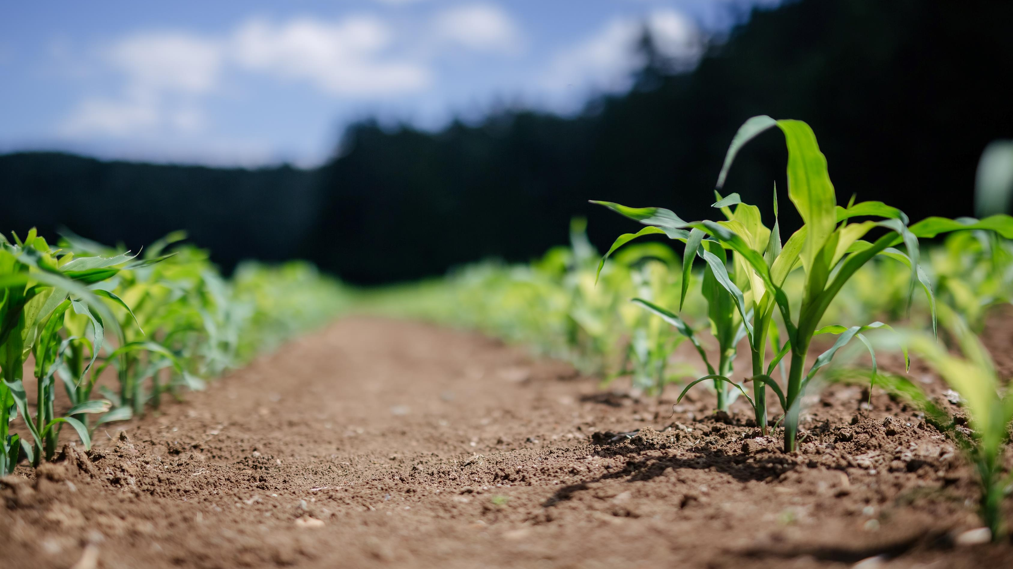
WOFOST Crop Model and Ensemble Generation
Hongyuan Ma
University College London
hongyuan.ma@ucl.ac.uk
Logos for

Slide 2

Outlines
Introduction of Crop Model
Principles of WOFOST model
Application of WOFOST
WOFOST Ensemble and Yield Map Generation

Slide 3
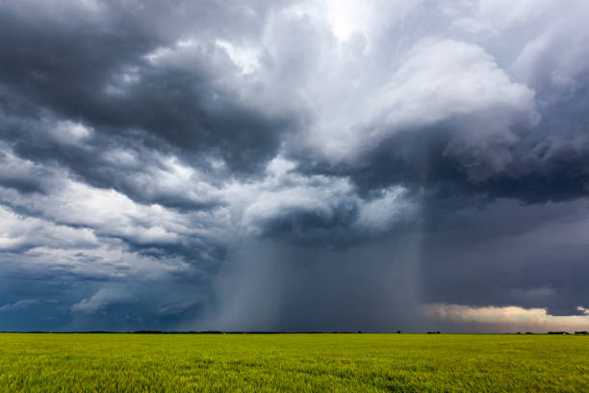
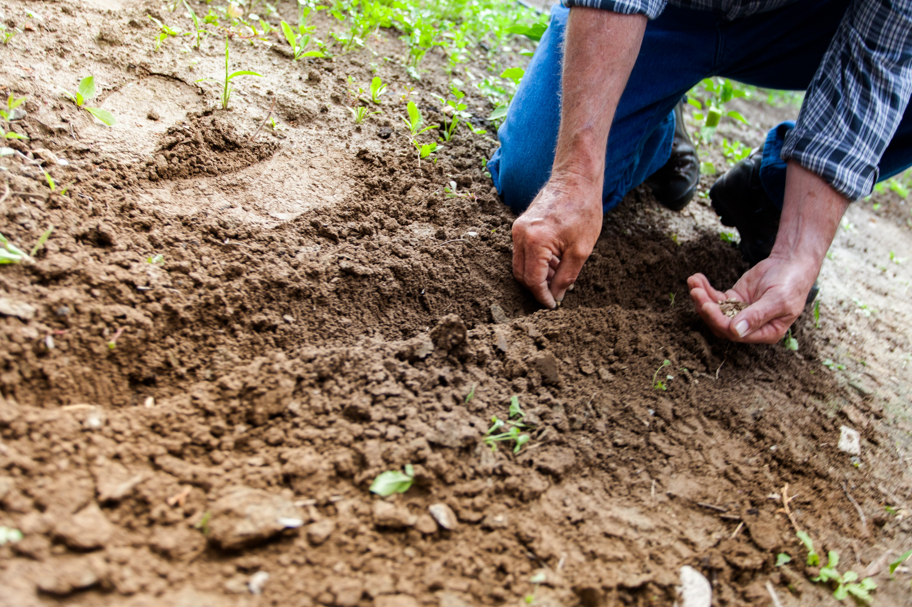
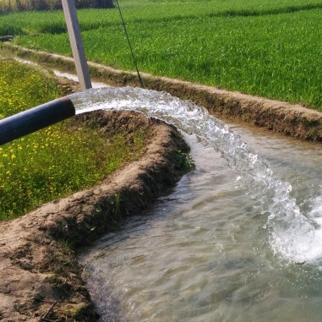
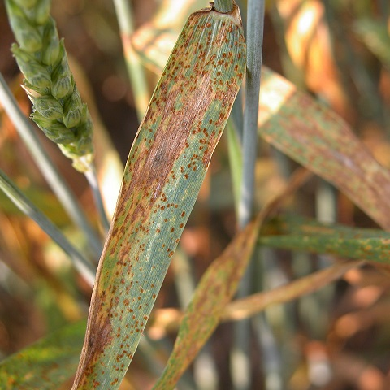
Introduction of Crop Model
Agriculture is a complex system involving the interaction of many factors, including environment factors (weather, soil, plant management) and biological factors (genetic characteristics, pests and diseases, weeds) .
Study on the interaction mechanism of soil-crop-atmosphere system and the actual production management service need accurate and quantitative describe the process of crop growth and development. Traditional agricultural experiment, field investigation and other research methods gradually cannot meet the needs, so it is necessary to use crop model as a new research and production tool.

Slide 4
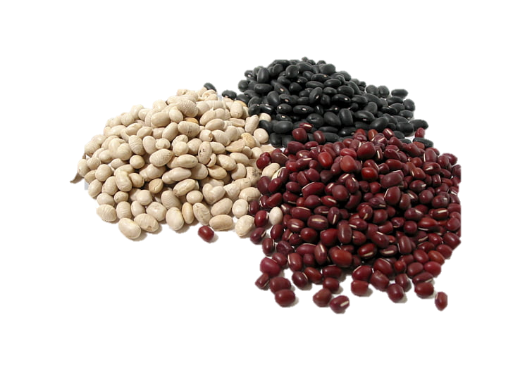

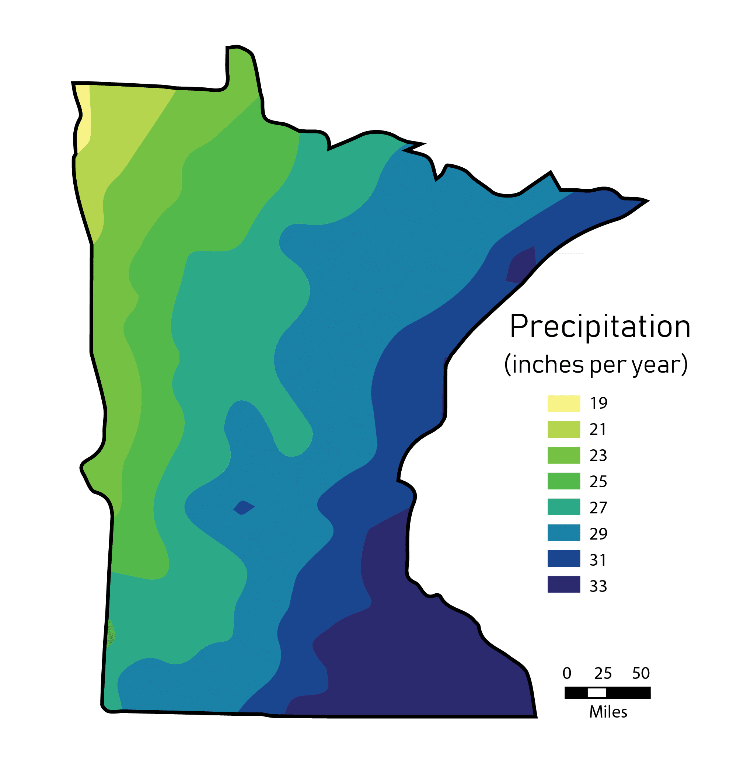


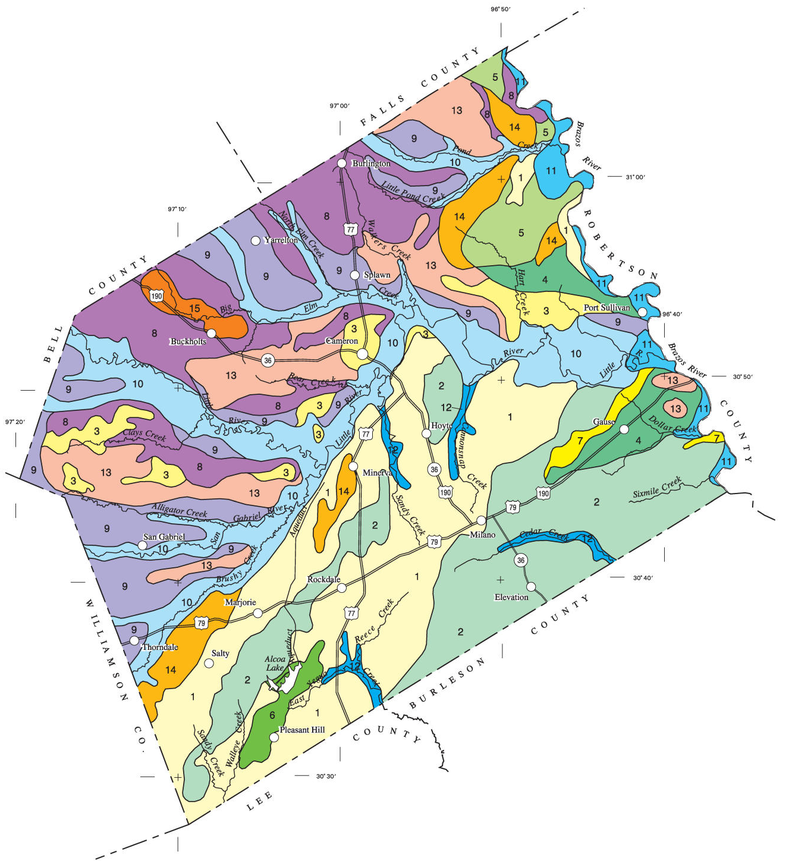

Introduction of Crop Model
Knowledge
Crop model are a formal way to present quantitative knowledge about how a crop grows in interaction with its environment.
Using weather data and other data about the crop environment, these models can simulate crop development, growth, yield, water, and nutrient uptake.
Weather
Management
Soil
Variety
Simulation
（Phenology,Growth, Yield）

Slide 5
Introduction of Crop Model
Application of Crop Model: Scientific Research
Estimation of biophysical parameters (LAI, ET, SM)
Yield and growth diagnosis
Irrigation optimization
fertilization schedule optimization
Impacts and responses to climate change
Carbon cycle in ecosystem
Crop variety planning and environmental impact assessment
Crop variety modeling

Slide 6
Introduction of Crop Model
Application of Crop Model: Agricultural sector
Production forecasting
Water and fertilizer management
Critical periods for use of agricultural machinery
Response and risk management for different meteorological scenarios
Targeted assistance and early warning for agricultural disasters
Agricultural commodity futures trading
Agricultural insurance

Slide 7
Principles of WOFOST model
Introduction of WOFOST
How the WOFOST simulates?
Application of WOFOST
WOFOST Ensemble and Yield Map Generation

Slide 8
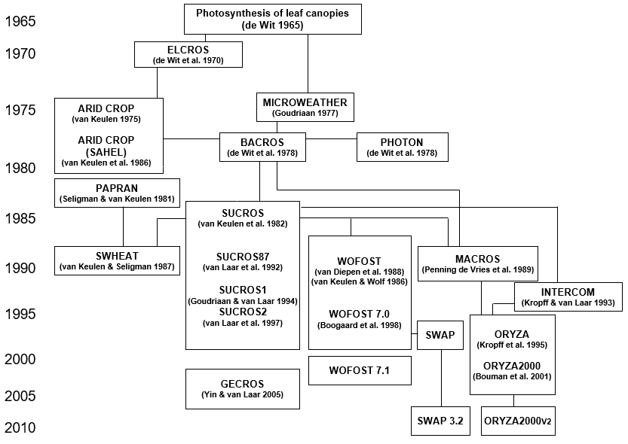
Principles of WOFOST model
Diagram of models of the ‘School of de Wit’
Focus on mechanism research
Based on canopy photosynthesis
Emphasize crop similarity
Different crops share the same framework
Applied to scientific research

Slide 9

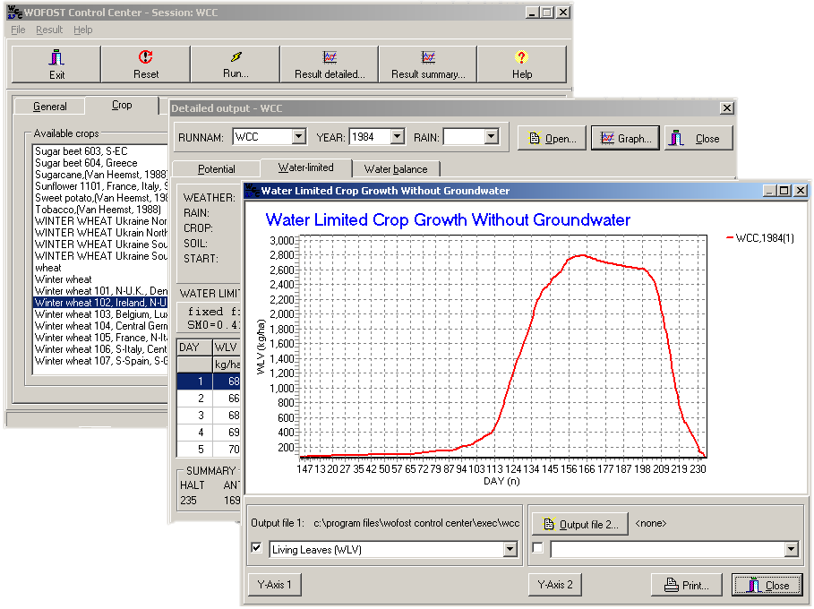
Principles of WOFOST model
WOFOST (WOrld FOod STudies) is a simulation model for the quantitative analysis of the growth and production of annual field crops. With WOFOST, you can calculate attainable crop yield, total biomass, water use, etc. for a location given knowledge about soil, crop, weather and crop management.
Generic function but different inputs
Opensource (Fortran and Python)
Easy to customize
With simple graphic interface for result analysis
https://www.wur.nl/en/Research-Results/Research-Institutes/Environmental-Research/Facilities-Products/Software-and-models/WOFOST.htm

Slide 10
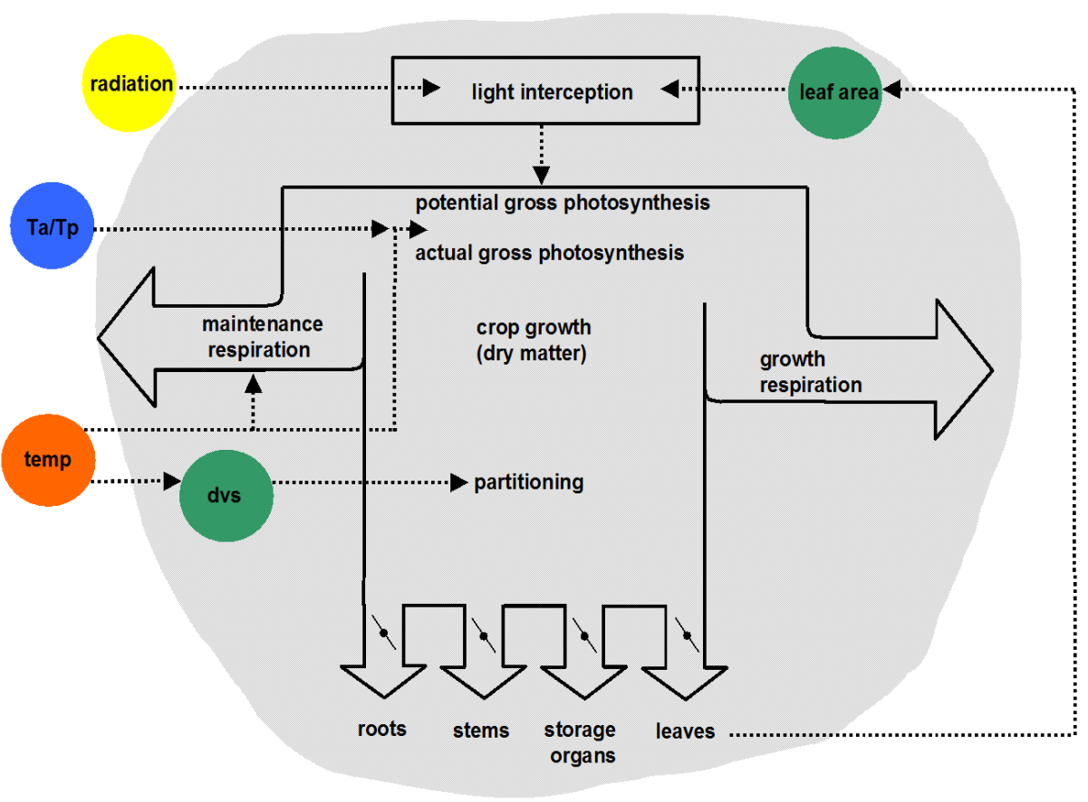
Principles of WOFOST model
Physiological processes in WOFOST(daily time steps)
phenology
Light interception
Assimilation (Photosynthesis)
Respiration
Assimilate partitioning
Leaf area dynamics (growth and decay)
Evapotranspiration
Soil water balance and drought response

Slide 11
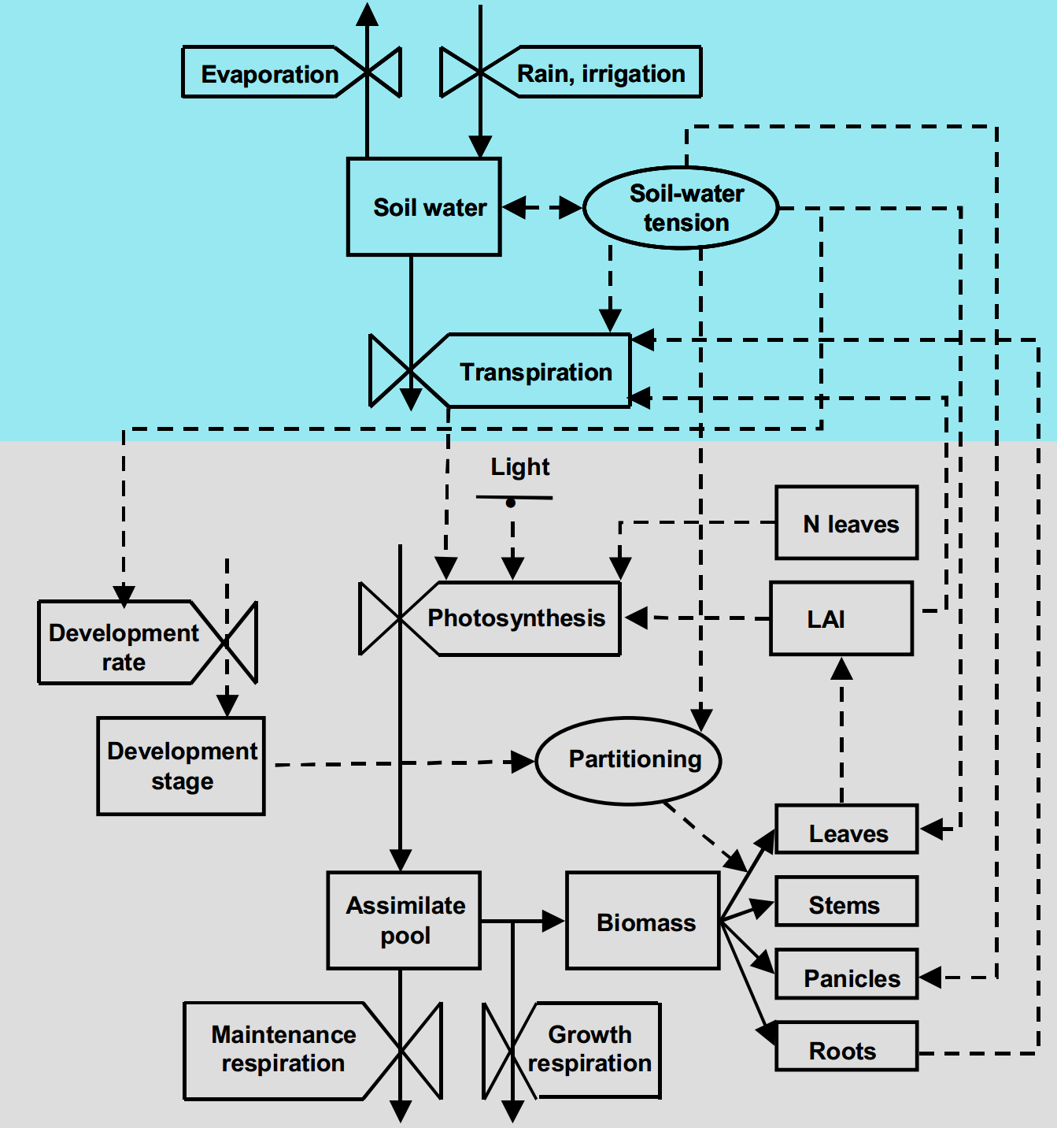
Principles of WOFOST model
Soil water simulation module
process
state
Crop simulation module
rate
driver

Slide 12
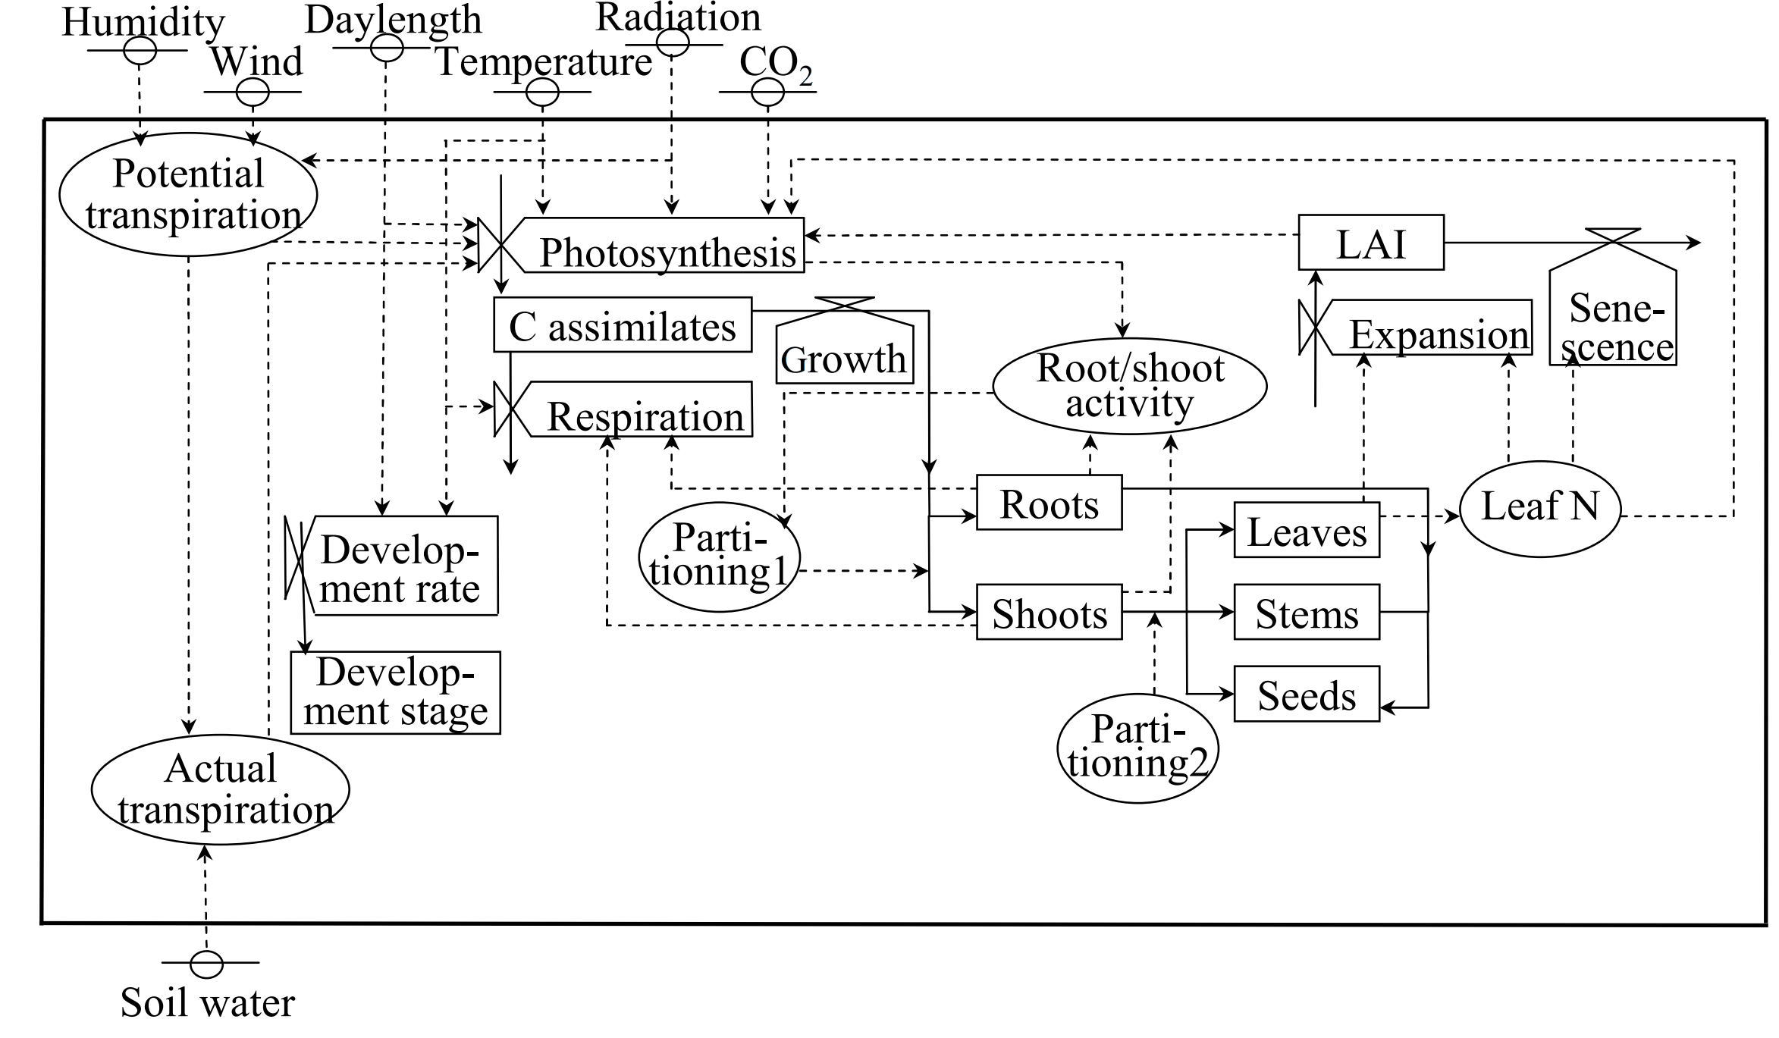
Principles of WOFOST model
process
state
rate
driver

Slide 13

Principles of WOFOST model
Potential
CO₂
Radiation
Temperature
Crop features
In WOFOST model, users can choose different simulation level to simulate the growth process of crops at corresponding production level conditions
Attainable yield
Defining factors
Production situation
Water
Nutrients
Production situation
Limiting factors
Weeds
Pests
Diseases
Pollutants
实际生长
减产因素
Actual yield
Reducing factors
Production level

Slide 14
Principles of WOFOST : Phenology
In WOFOST, DVS represents phenology stages, it’s controlled by heat sums
Controlling WOFOST parameters:
TBASEM
DVS tsum stage
- - sowing
TSUMEM
0 emergence
TSUM1
1 flowering
TSUM2
2 maturity
TEFFMX
TSUMEM
DTSM
TSUM1
TSUM2
DLO, DLC

Slide 15
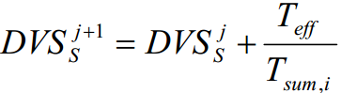
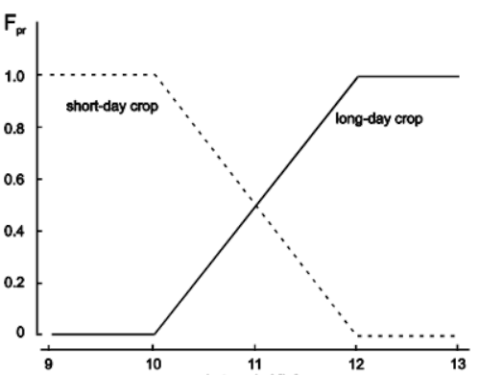
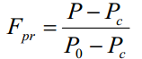
Principles of WOFOST : Phenology
When other factors are basically satisfied, temperature plays a dominant role in development.
Daily increase in thermal timeºC.d-1
30
T_{eff}(℃)
25
T_{max,e}
20
15
10
daylength(h)
5
T_{b}
0
For some species sensitive to light duration, the DVS will be multiple with a reduction factor of the day-length effect:
0
8
30
40
Daily average temperature ºC

Slide 16
Principles of WOFOST : Photosynthesis
Photosynthesis module including these process:
Solar radiation at top of canopy
Solar radiation within canopy
Intercepted radiation
CO₂ assimilation
Simplified procedure in WOFOST:
3 x 3 points per day (three solar elevations * three canopy depths)

Slide 17
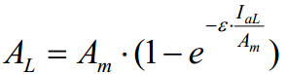
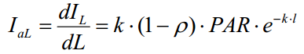
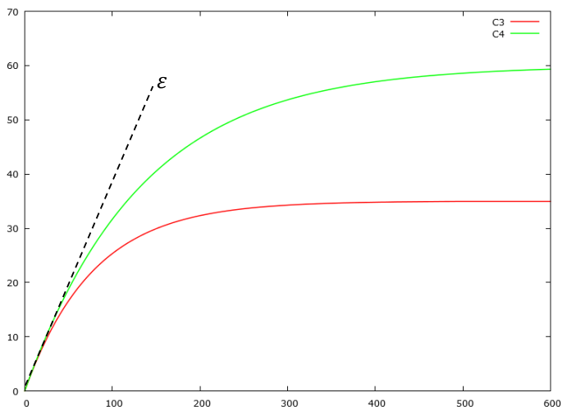
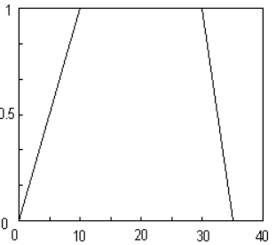
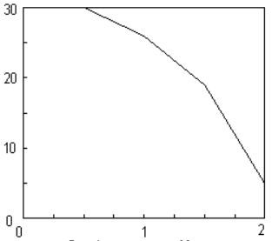
Principles of WOFOST : Photosynthesis
Instant assimilation rate
So assimilation rate was controlled by genetic features of crops (A_{m}, initial light-use efficiency of single leaf: ε(kg J⁻¹), reflection coefficient: ρ, radiation extinction coefficient: k), LAI and PAR.
photosynthesis rate
(kg/ha/h)
Controlling WOFOST parameters:
EFF(Initial Light use Efficiency), AMAX, TMPF(Tmean response), TMNF(Tmin response)
TMPF
AMAX
Absorbed radiation (J/m²/s)
DVS
Daily average temp

Slide 18

Principles of WOFOST : Respiration
Respiration including maintenance respiration and growth respiration (conversion losses) , they consume 15-30% and 30-40% of all assimilates separately. it’s calculated by:
Maintenance respiration was calculated by:
Biomass of living plant organs
Maintenance coefficient per plant organ (RMO, RMS, RML, RMR)
Q₁₀ :specifies relative increase with each 10 ºC increase in daily maximum temperature
Temperature, maintenance respiration increases rapidly with temperature
Growth respiration was calculated by:
Partitioning biomass over organs
Conversion coefficient per plant organ (RMO, RMS, RML, RMR)
Controlling WOFOST parameters:
CVO,CSV,CVL,CVR,Q10
$$R_{g}={(1−C_{e})(R_{d}−R}_{m,T})$$
Controlling WOFOST parameters:
RMO, RMS,RML, RMR,Q10
$$R_{m,T}=R_{m,r}Q_{10}\frac{T−T_{r}}{10}$$

Slide 19
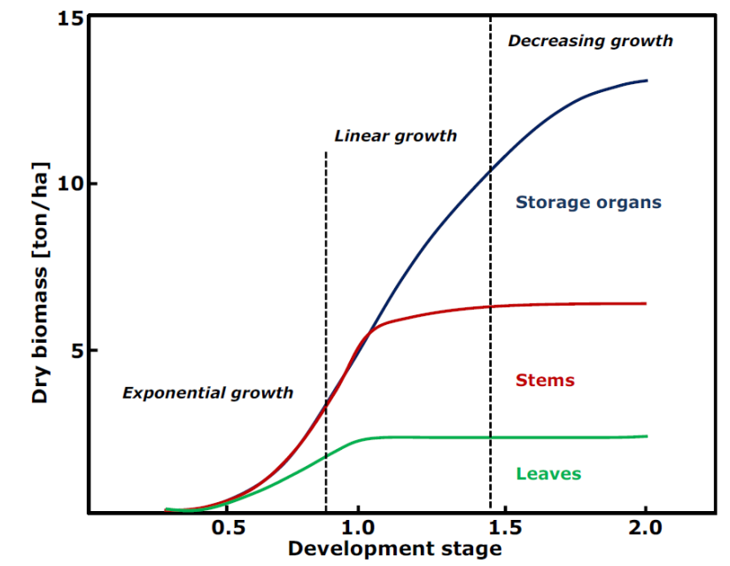
Principles of WOFOST : Partitioning
Assimilates are distributed over different plant organs after respiration. It depend on development stage.
Two stage partitioning in WOFOST:
Below-ground e.g. roots (FRTB)
Above-ground (1 – FRTB): must add up to 1.0
• Leaves (FLTB)
• Stems (FSTB)
• Storage organs (FOTB)
Controlling WOFOST parameters:
FRTB, FSTB, FLTB, FOTB

Slide 20
Principles of WOFOST : Leaf area dynamics
Leaf growth:
Driven by increase in leaf biomass
Conversion to leaf area through specific leaf area (SLA = m2 of leaf per kg biomass)
Leaf area growth can be source or sink-limited
Leaf decline (senescence):
Aging of leaves
Drought stress or self-shading
Stems and pods can also contribute to the leaf area
Requires book-keeping of leaf age classes for biomass, SLA and leaf age!

Slide 21
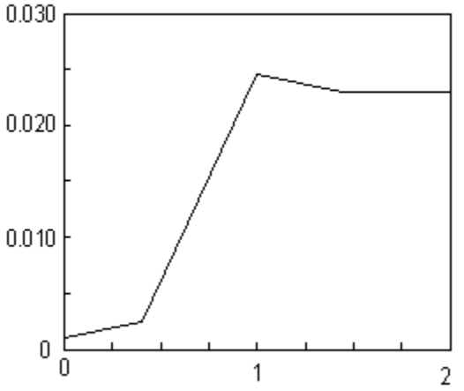
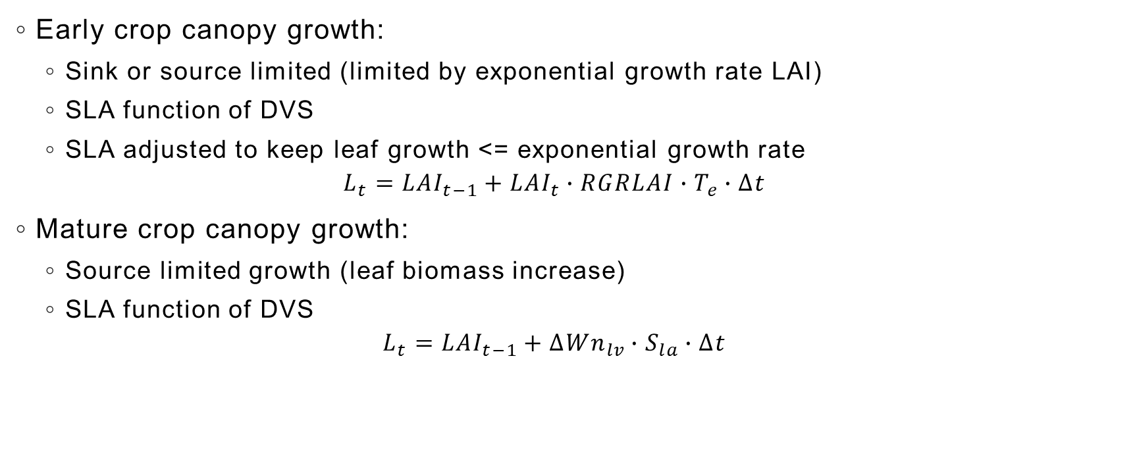
Principles of WOFOST : Leaf area dynamics
Early crop canopy growth:
Sink or source limited (limited by exponential growth rate LAI)
SLA function of DVS
SLA adjusted to keep leaf growth <= exponential growth rate
$$L_{t}={LAI}_{t−1}+{LAI}_{t}∙RGRLAI∙T_{e}∙∆t$$
Mature crop canopy growth:
Source limited growth (leaf biomass increase)
SLA function of DVS
$$L_{t}={LAI}_{t−1}+∆{Wn}_{lv}∙S_{la}∙∆t$$
SLA
Controlling WOFOST parameters:
RGRLAI, TDWI, SLA, LAIEM
DVS

Slide 22
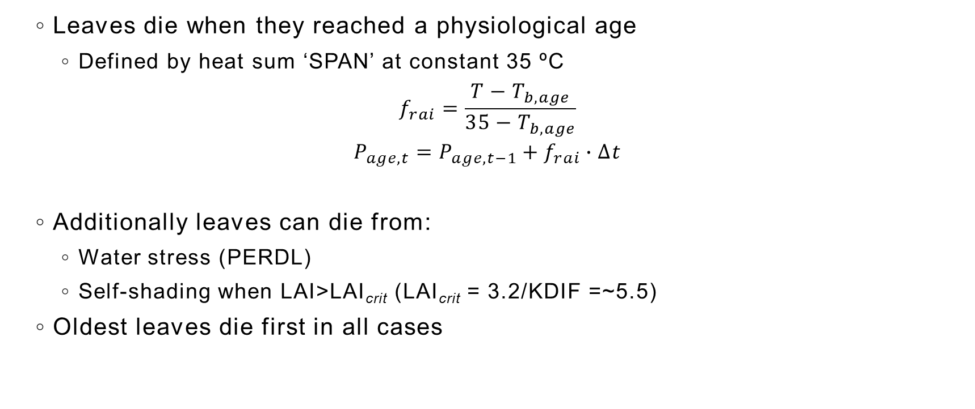
Principles of WOFOST : Leaf senescence
Leaves die when they reached a physiological age
Defined by heat sum ‘SPAN’ at constant 35 ºC
$$f_{rai}=\frac{T−T_{b,age}}{35−T_{b,age}}$$
$$P_{age,t}=P_{age,t−1}+f_{rai}∙∆t$$
Additionally leaves can die from:
Water stress (PERDL)
Self-shading when LAI>LAI_{crit} (LAI_{crit} = 3.2/KDIF =~5.5)
Oldest leaves die first in all cases
Controlling WOFOST parameters:
TBASE, PERDL, SPAN

Slide 23

Principles of WOFOST : Transpiration
In water-limited level, actual CO2 assimilates are affected by transpiration.
$$R_{d}={\frac{T_{a}}{T_{p}}R}_{d}^{1}$$
Crop water use is calculated separately for:
Crop canopy (transpiration)
Bare soil surface (soil evaporation)
Soil surface with ponding (water evaporation)
Transpiration:
Reference ET multiplied with correction factor (CFET)
Maximum ET as a function of LAI
Limited by soil moisture
Soil/Water Evaporation:
Reference ET * shading_factor(LAI)
θ
wp
θ
cr
θ
fc
θ
st

Slide 24
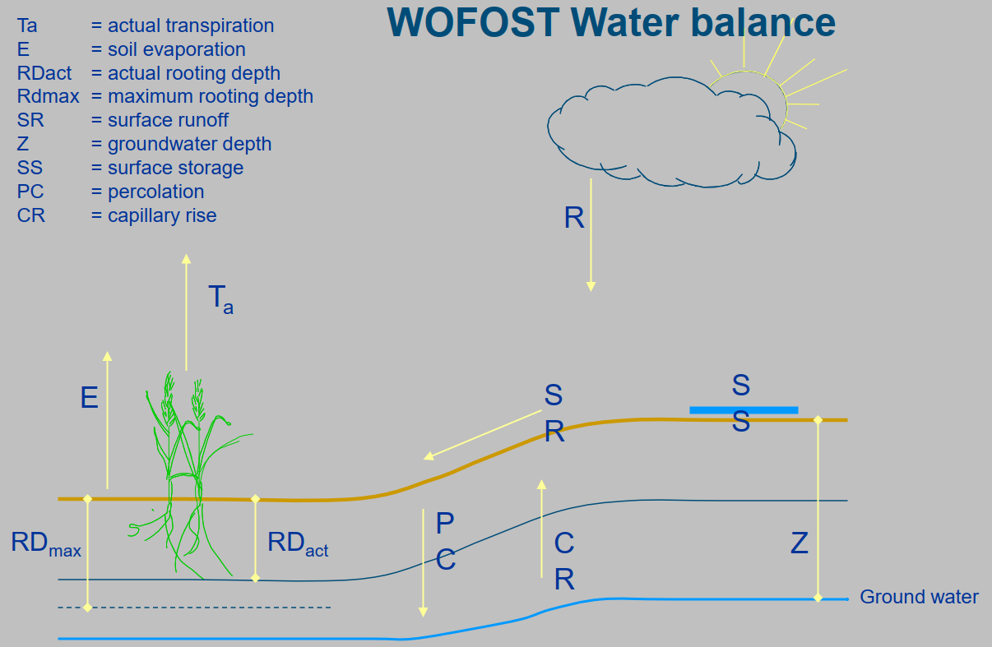
Principles of WOFOST : Water Balance

Slide 25
Principles of WOFOST : Limitations
Inherent to simulation technique:
Multi-parameter model, difficult to calibrate and validate
Sensitive for initial state of soil and crop
Chosen generalizations
No crop architecture
Homogeneous canopy
No translocation of assimilates between organs.
Chosen system boundaries (point scale, single season)
Limited knowledge of crop response relations (empirical relations, severe stress)
Not simulated: Winter dormancy, vernalization; winter kill; Cold stress, heat stress; Damage by hail and strong winds; Sensitive stages for drought stress; Damage from excess water, flooding; Management response (e.g. resowing); Effect of weeds, diseases, animals; Yield quality; Harvest losses

Slide 26
Application of WOFOST
Input data of WOFOST including:
Weather driver: Radiation, Tmax/Tmin, vapour pressure, rainfall, wind speed
Crop parameters: Emergence, Phenology, Initial condition, Assimilation, Leaf dynamic, Partitioning, Respiration, Senescence, Water use.
Management parameters: Sowing, Irrigation
Soil parameters:

Slide 27
WOFOST Ensemble and Yield Map Generation
Introduction of WOFOST
How the WOFOST simulates?
Application of WOFOST
WOFOST Ensemble and Yield Map Generation

